Slide 1

EAI6010 Applications of Artificial Intelligence Document Classifier and Text Extractor
Debriyo Roy
Praveen pravesh pandey
Harsh Sindhwa
Atharva Kousadikar
Prof. Sergiy Shevchenko

Slide 2
Table of Contents
Project Introduction
2. Steps followed to perform Classification and Text Extraction
2.1 Labelling the Forms.
2.2 Performing Classification
2.3 Evaluating different classification models
2.4 Text Extractions
2.5 Storing attributes in csv file
3. Google Vision API
4. UI for Classification and Text Extraction.
5. Conclusion and References

Slide 3
Project Introduction
Scope of this project is to classify different kinds of forms and extract text.
Project Procedure
Forms were named into four different categories
Image classification algorithms such as Resnet50 and VGG16 were used
Images were cropped in order to get the essential features such as demographic information,etc.
Features(text embedded in the images) were extracted using Tesseract and Google Vision API

Slide 4
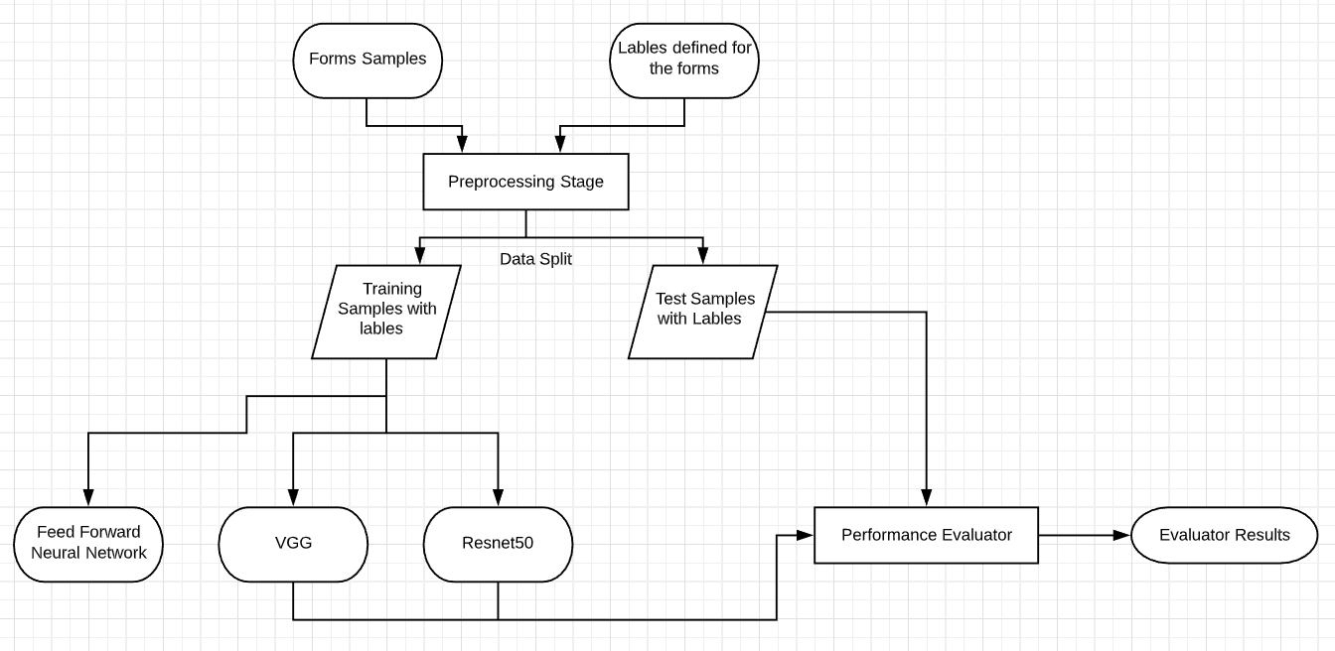
Flow Diagram For Classification

Slide 5
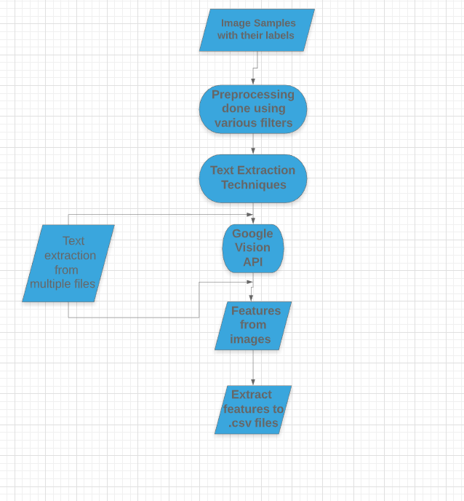
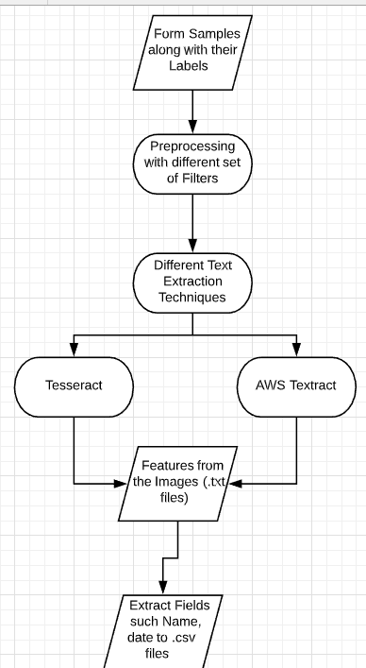
Text Extraction Flow

Slide 6
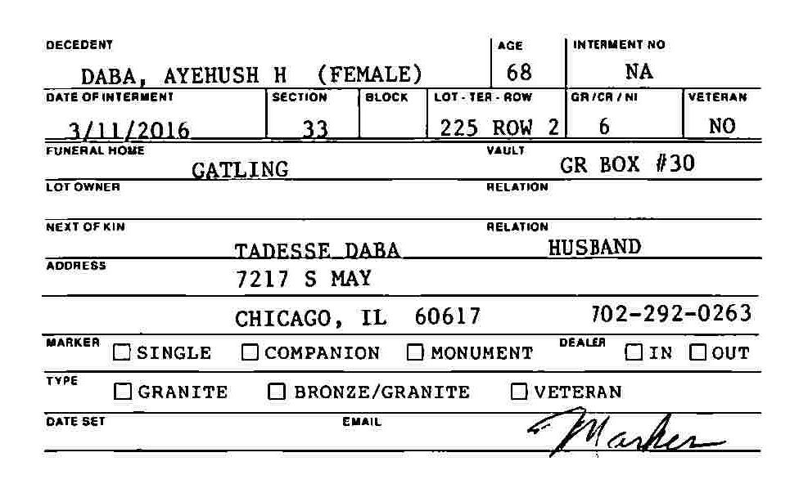
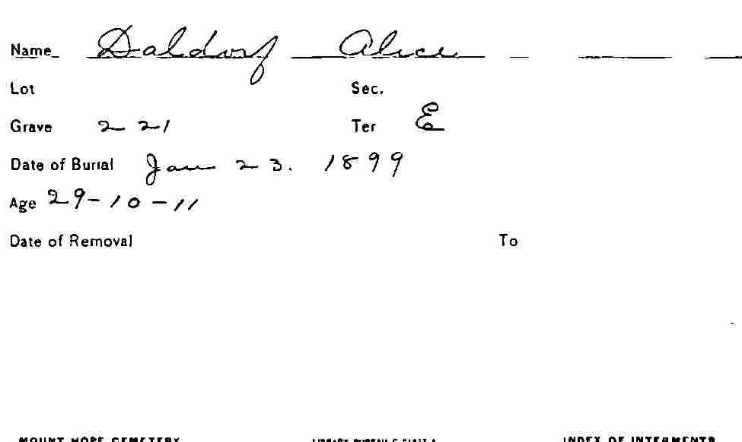
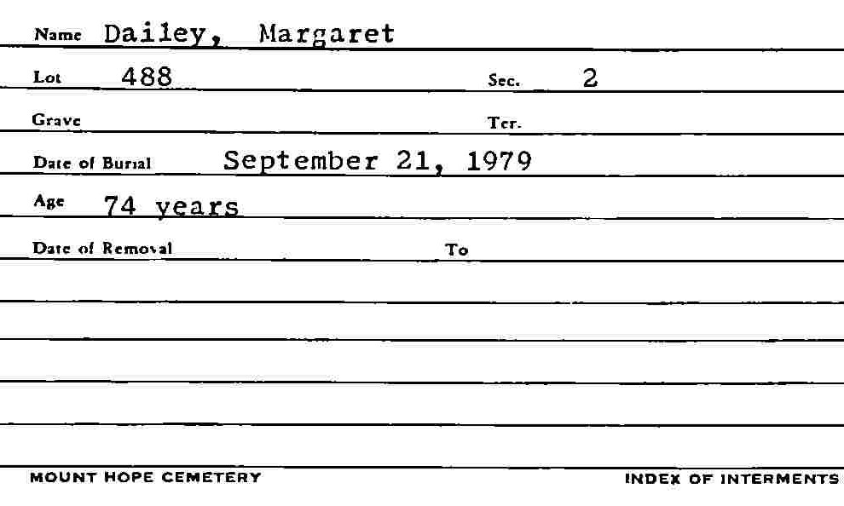
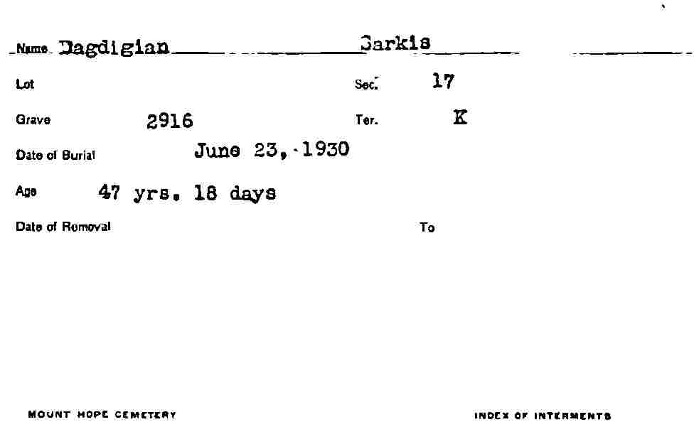
2.2 Labelling Forms
Type I Block Forms
HandWritten Forms
Type 3 Line Forms
Type 2 Typed Empty forms
There are total 500 images to be classified they are labelled in above mentioned types for classifying.
Notes:
Visual Geometry Group (VGG) model
Saved images in different folders, set a path for main directory , load image, convert it to array

Slide 7
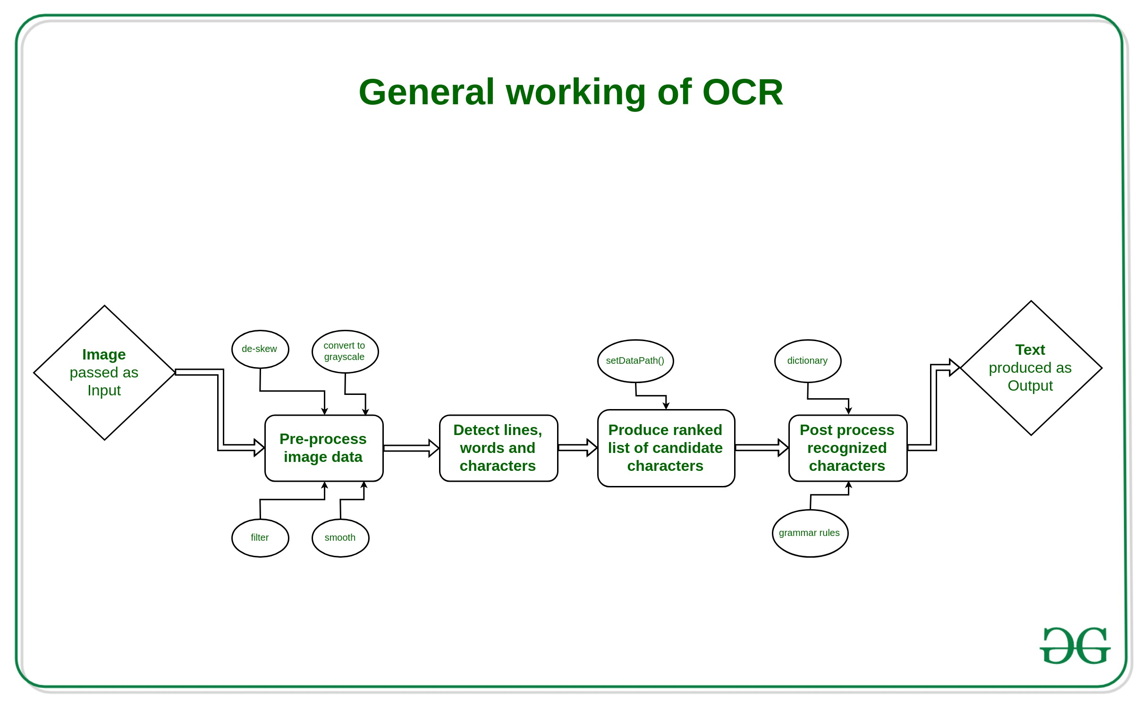
2.3 Text Extraction
1
We have Cropped the images for extracting the necessary information and removing the unwanted information.
2
We have used tesseract and opencv to extract information from the images.
We have set the dpi to 300 to return the number of pixels per inch.
3
We use opencv to preprocess the text data to smoothening and removing the noise from the text data.Using tesseract and Google Vison API we detect an put the results in csv file
Reference:https://media.geeksforgeeks.org/wp-content/uploads/20190530190230/General-working-of-OCR-3.jpg

Slide 8
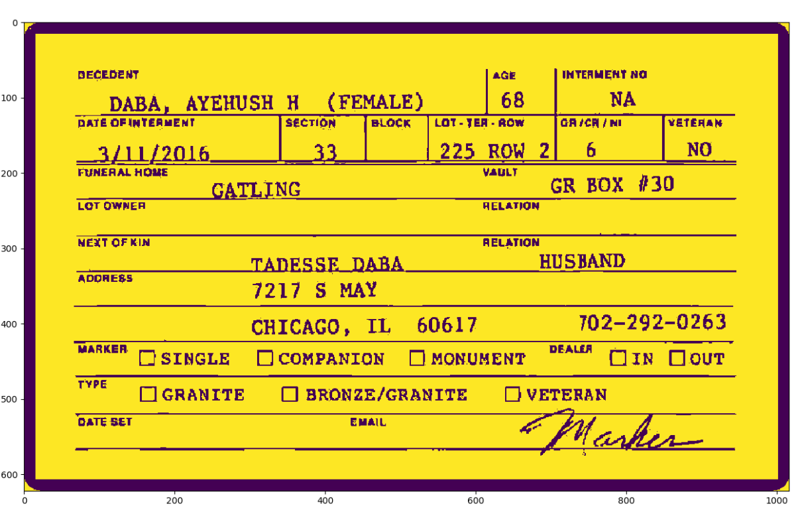
Image Processing
Scaling Image
Re-sizing Image
Setting Image DPI
Image Smoothening using bilateral filter
Removing noise from image

Slide 9

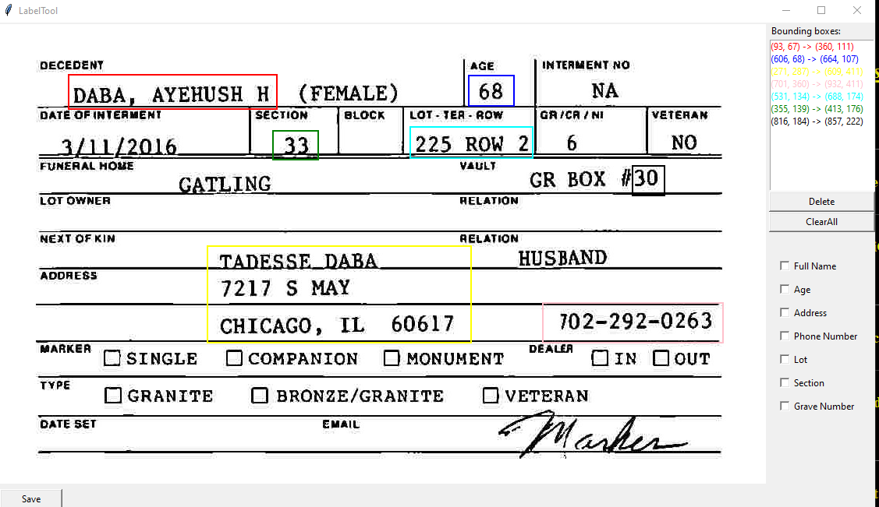
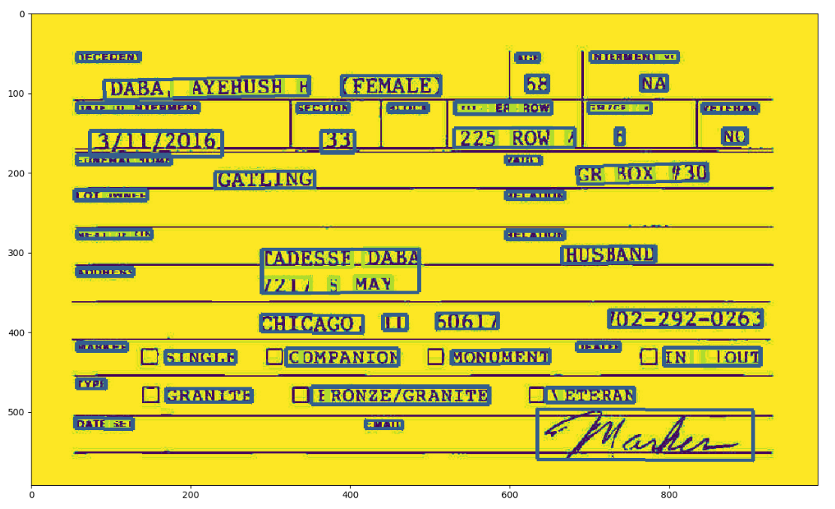
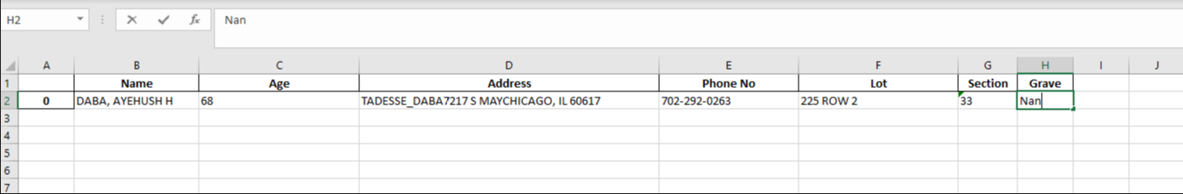
Image Pre-processing
Bounding Box
Google Vision
Bounding Box using Tkinter
Attributes stored in csv

Slide 10
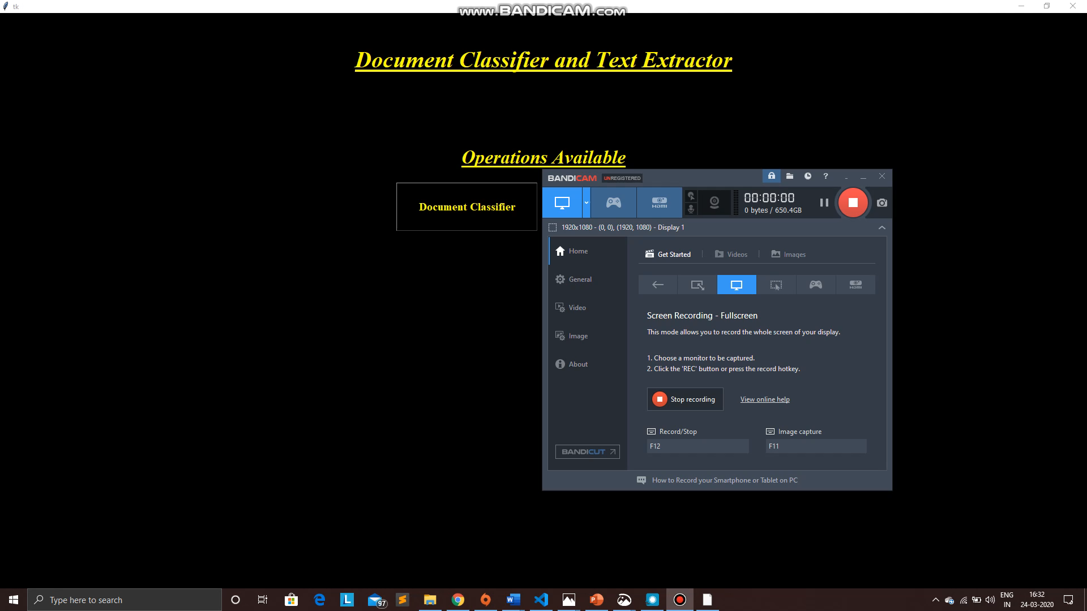
Document Classifier and Text Extractor application

Slide 11
Conclusion
Using simpler models like FNN there is a chance of miss-classification with Hand Written forms.
VGG 16 and ResNet 50 models are performing well in classifying forms. They both have accuracy of 98%.
Major information was extracted from the images using Tesseract and Google Vision Api. The attributes were stored in a csv file.
Text Extraction conducted don single and multiple files for analysis.
Developed a User Interface to Classify and extract text from forms to automate the process.

Slide 12
References:
Brownlee, J. (2019, August 7). How to Prepare a Photo Caption Dataset for Training a Deep Learning Model. Retrieved from https://machinelearningmastery.com/prepare-photo-caption-dataset-training-deep-learning-model/.
Radhakrishnan, P. (2019, October 26). What is Transfer Learning? Retrieved from https://towardsdatascience.com/what-is-transfer-learning-8b1a0fa42b4.
Brownlee, J. (2019, September 2). Transfer Learning in Keras with Computer Vision Models. Retrieved from https://machinelearningmastery.com/how-to-use-transfer-learning-when-developing-convolutional-neural-network-models/.
Vaibhaw,S. (June 6, 2018). Deep Learning based Text Recognition(OCR) using Tesseract and OpenCV. https://www.learnopencv.com/deep-learning-based-text-recognition-ocr-using-tesseract-and-opencv/.
https://www.tensorflow.org/tutorials/images/transfer_learning
Adrian, R., (2018). OpenCV OCR and text recognition with Tesseract
Gidi. S., (2019). Introduction to OCR with tesseract and OpenCV

Slide 13
Thank You

